Slide 1
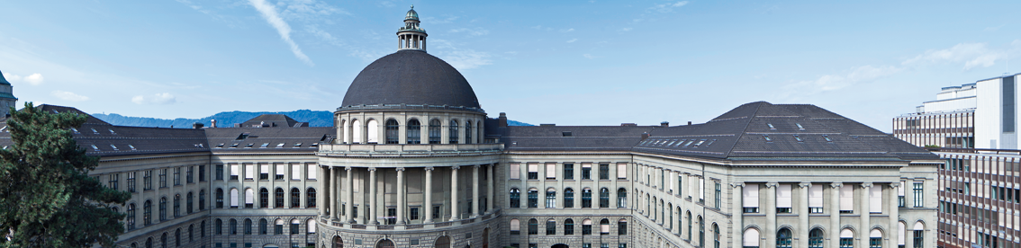
Reconstructing the World* in Six Days *(As Captured by the Yahoo 100 Million Image Dataset)
3D Vision Paper Presentation by Varin Buff, Gian-Andrea Heinrich, Björn Joos, Robin Stähli

Slide 2
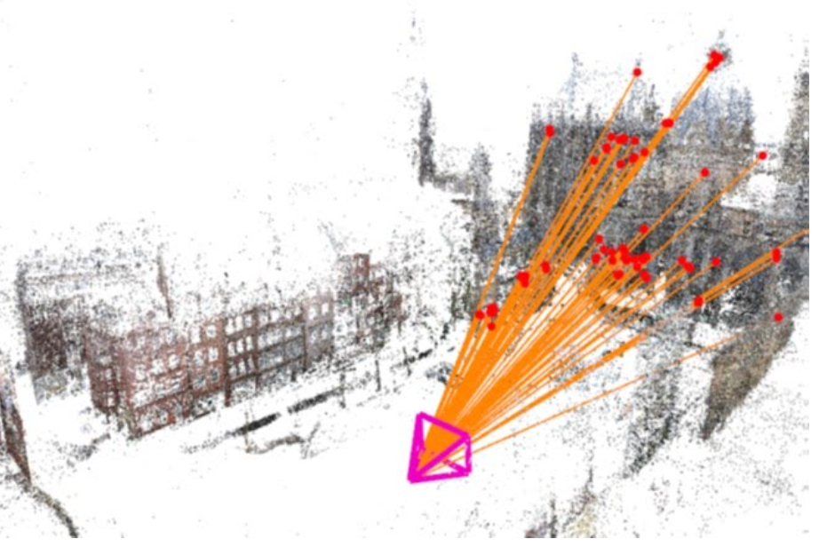
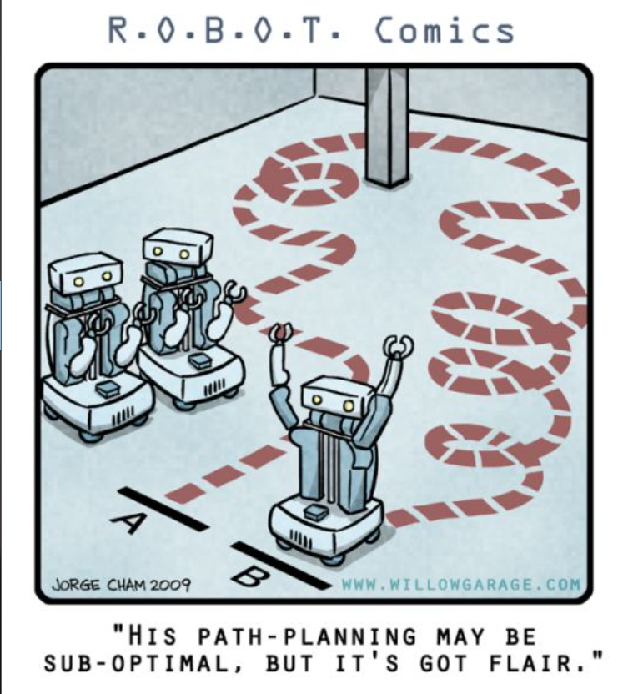
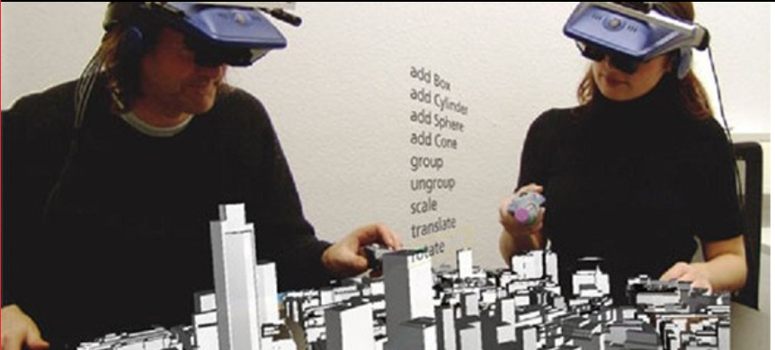
Why is it important?
Major goal over decades
Tremendous amount of image data
Fast increasing
Many Applications
Virtual Reality
Image based localization
Autonomous Navigation
Etc.
)
Notes:
Modeling the world from images has been a major Goal for Computer Vision
Fast growing. (Approx 10% of all pics were made last year)
KURVE MIT BILDER SUCHEN

Slide 3
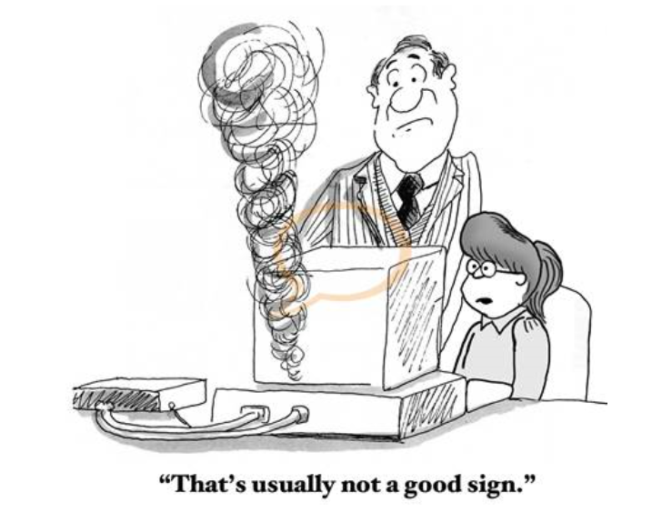



Challenges
Data Robustness
Compute & Storage Scalability
Registration Comprehensiveness
Model Completeness
Notes:
• Data Robustness: Enable the modeling from unorganized and heterogeneous Internet photo collections. • Compute & Storage Scalability: Achieve efﬁciency to meet the true scale of Internet photo collections
• Registration Comprehensiveness: Identify as many camera-to-camera associations as possible.
• ModelCompleteness: Build3Dscenemodels that are as extensive and panoramic as possible.

Slide 4
Other Works – Achievements and Challenges
 | Year | Achievements | Challenges | #Images
Frahm et al. | 2010 | Arguably the most scalable approach | Compromises in model completeness | 1’000’000 single PC/ 24h
Agarwal et al. | 2011 | Image recognition by retrieval-based overlap detection | High Computing Power needed | 150’000 (24h with 62 Computer cluster)
Nister et al. | 2006 | Features to “words” Introduction of Vocabulary Tree | - | -
Havlena et al. | 2014 | Significant increase in performance | Large memory consumption → not scaleable | Less than 1’000’000 >24 h with GPU cluster
Klingner et al. | 2016 | Image overlap detection on World-scale | Known geolocation needed, Sparse model | 2000 core-years for ww SfM cloud
Notes:
Nister et al rausnehmen
Frahm et al. LS-SfM and dense reconstruction from city-scale Internet photo collections of millions of images on a single PC in less than 24 hours. Their approach used a binary appearance representation to derive an iconic scene representation for efﬁcient registration and SfM.
Agarwall:
Their method similarly leveraged the beneﬁtsofimagerecognitionthroughretrieval-basedimage overlap detection.
Havlena propose to circumvent feature matching and pairwise image veriﬁcation altogether by using vocabulary-tree-based image retrieval as the correspondence mechanism. Each image pair with sufﬁcient overlap in its visual words is then directly used as an overlapping pair for the reconstruction.
fKlingneretal.[16],where Google StreetView images are used to enable a world-scale reconstruction. This method circumvents the challenging problem of image overlap detection and connected component discovery at world-scale by exploiting the known geolocation to perform windowed bundle adjustments for pose reﬁnement for the cameras

Slide 5

Novelties – Improvements
Higher Performance
Scalable
Higher Model Completeness
No knowledge of geo-location needed

Slide 6
References Part 1
http://nerei.org/wp-content/uploads/2016/07/Nerei-Virtual-reality-Environments-612x278.jpg (13.08.2018)
https://cdn.instructables.com/FMK/1ZLS/J283520X/FMK1ZLSJ283520X.MEDIUM.jpg (13.08.2018)
https://www.frsco.com/completeness/ (15.03.2018)
https://sites.google.com/site/yorkyuhuang/_/rsrc/1455602233247/home/research/computer-vision-augmented-reality/image-based-relocalization-in-slam/image_camerapose.jpg (13.08.2018)
http://www.cartoonresource.com/archive/education-teachers/teaching/computer-is-smoking.aspx (13.08.2018)

